Slide 1

SADI-S
vs
RYGBP
Dr Fabrizio Bellini

Slide 2
SADI-S
vs
RYGBP
Dr Fabrizio Bellini

Slide 3
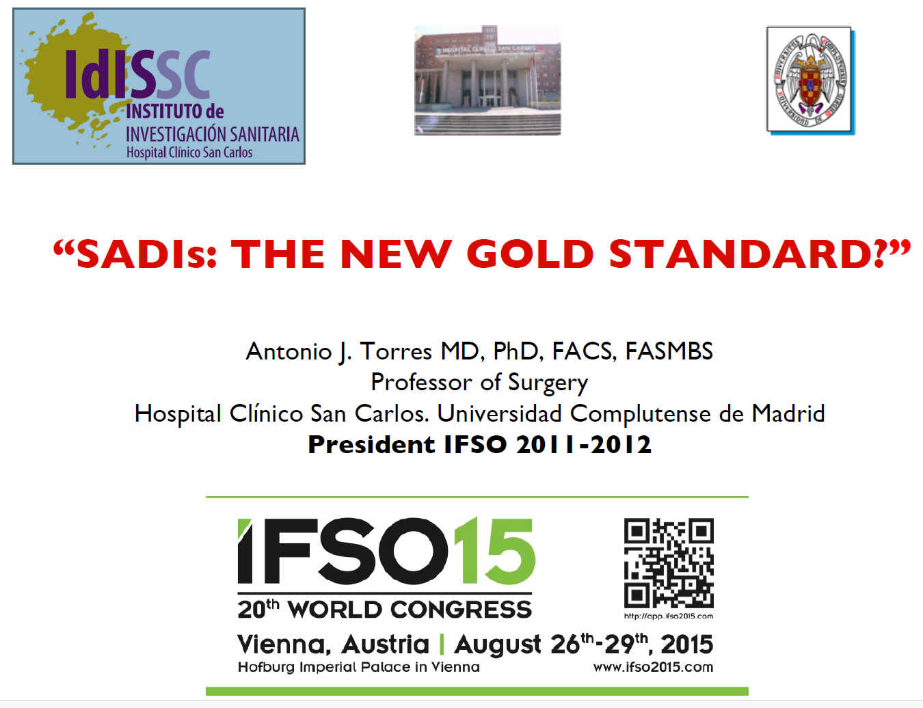

Slide 4
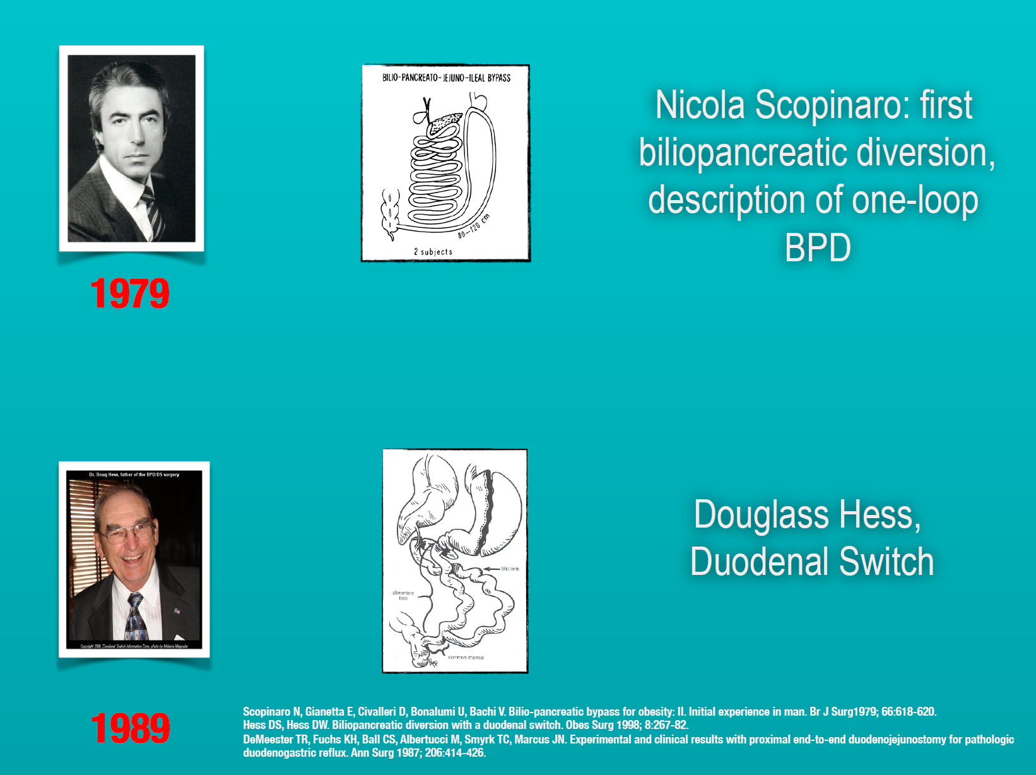

Slide 5
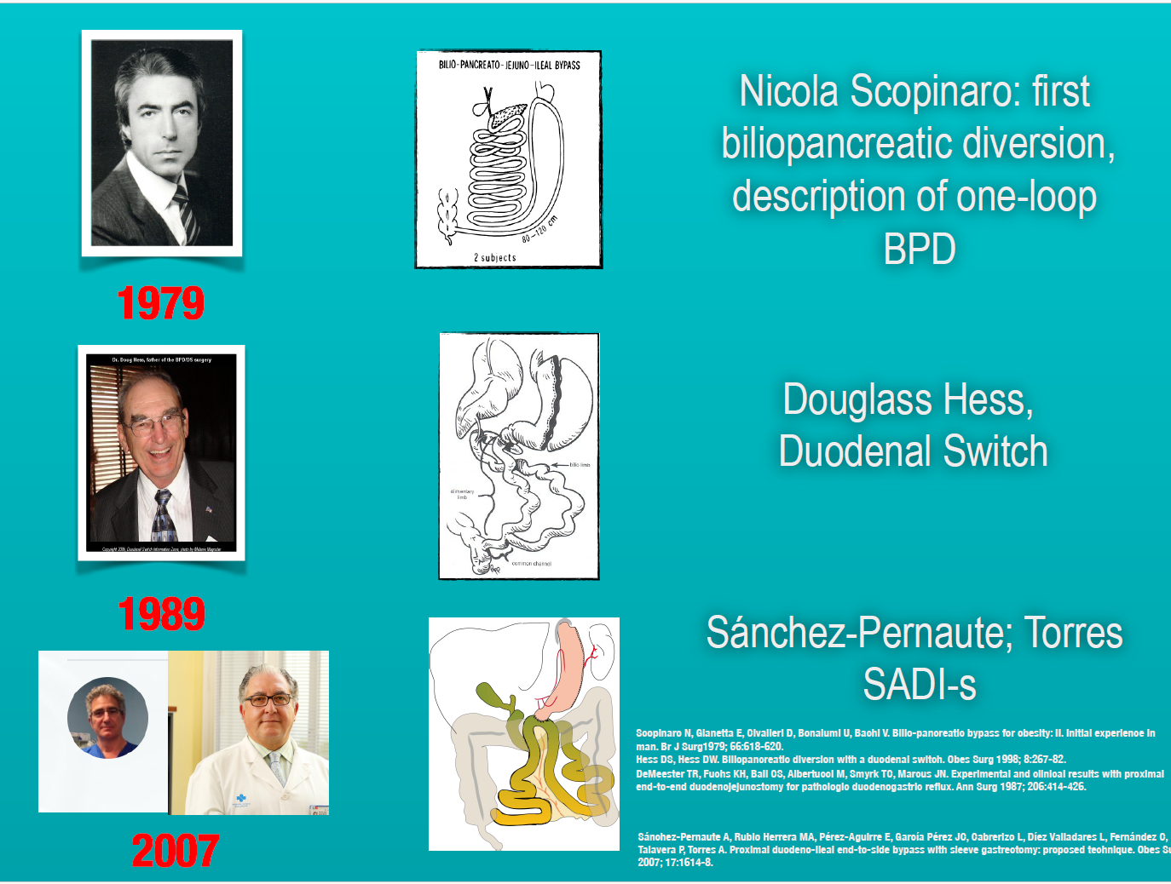

Slide 6
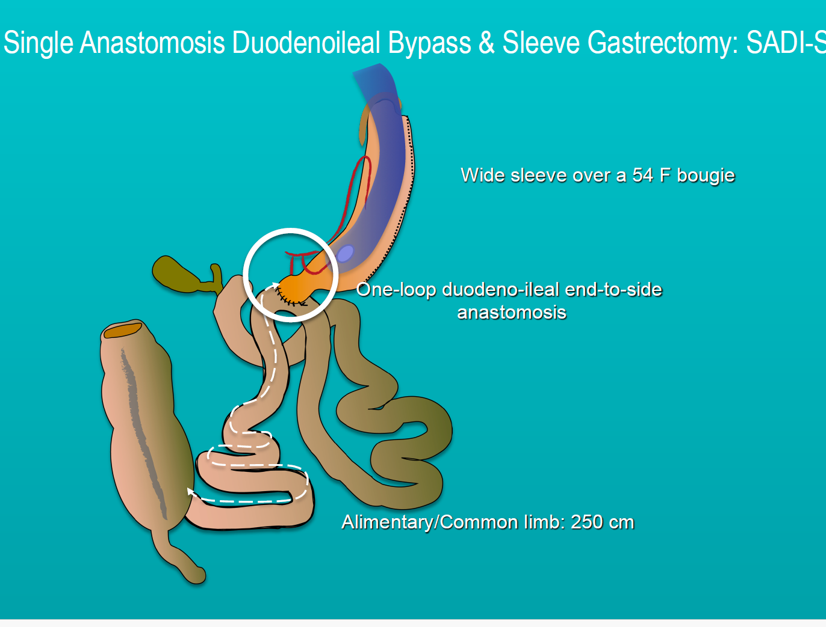

Slide 7
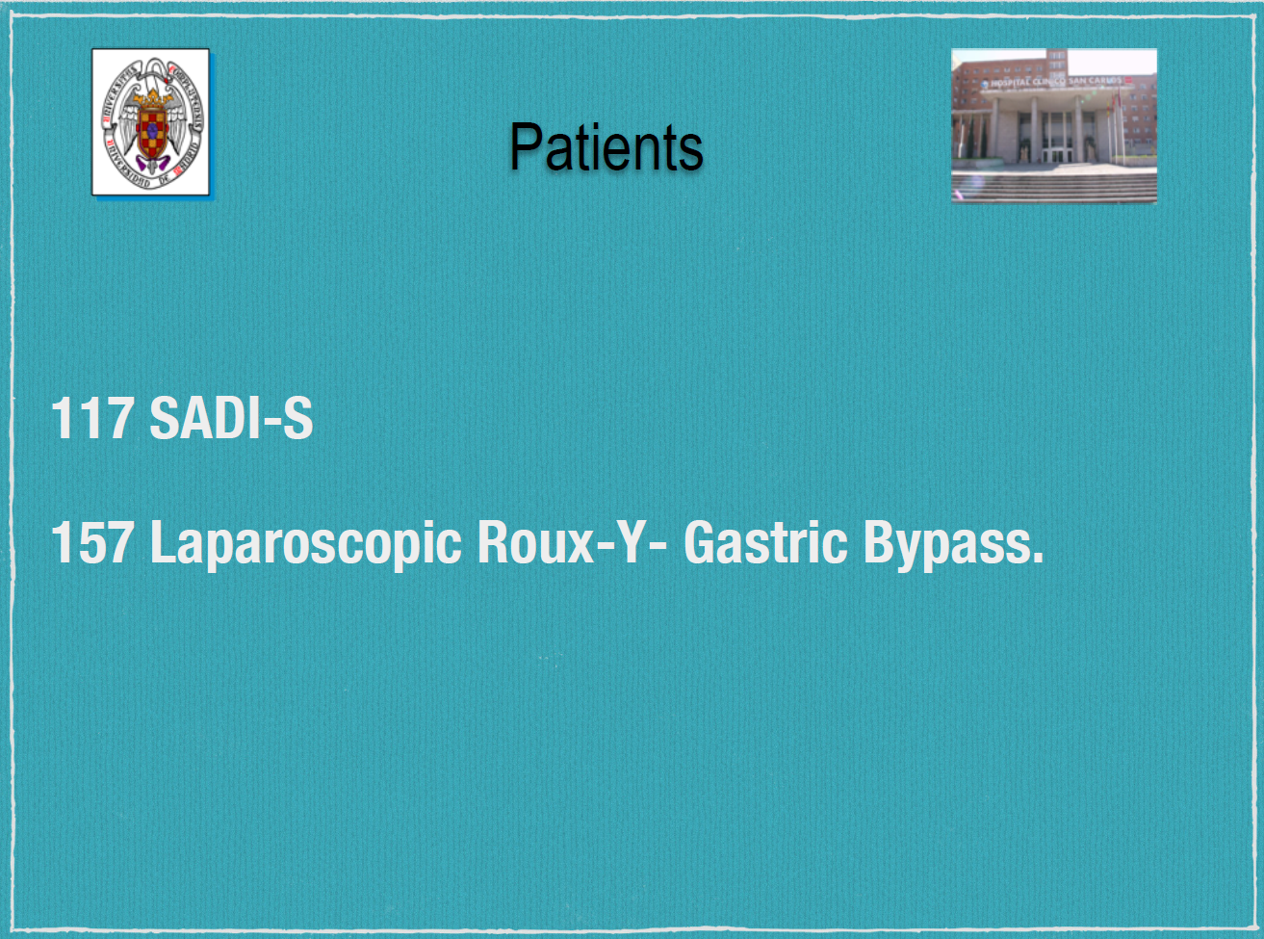
Notes:
In quella occasione Torres fece la prima comparazione tra SADIS E RYGBP

Slide 8
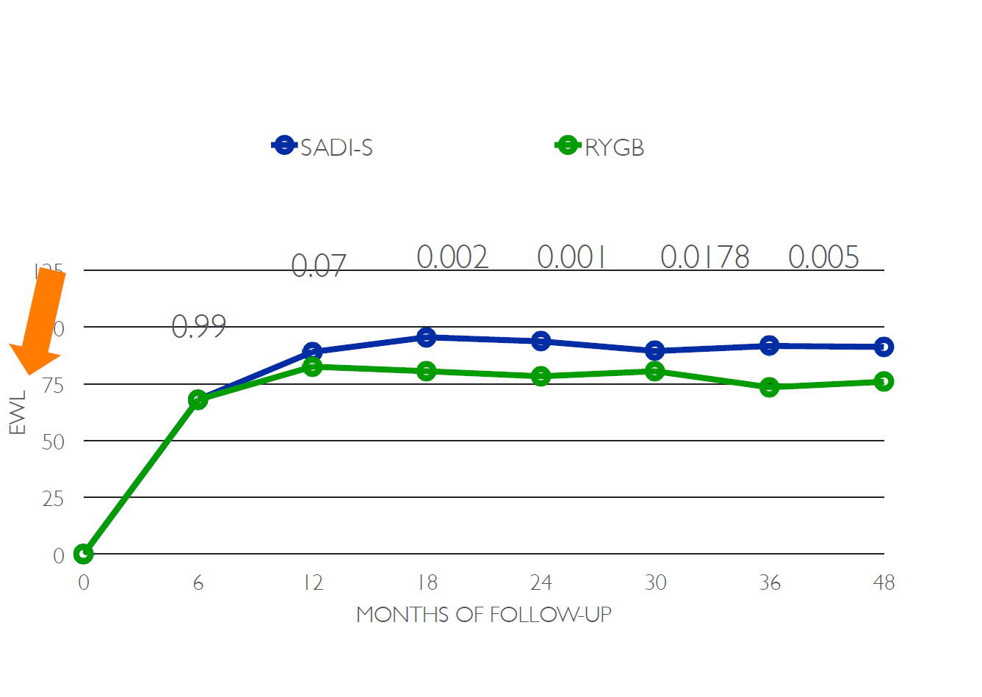

Slide 9
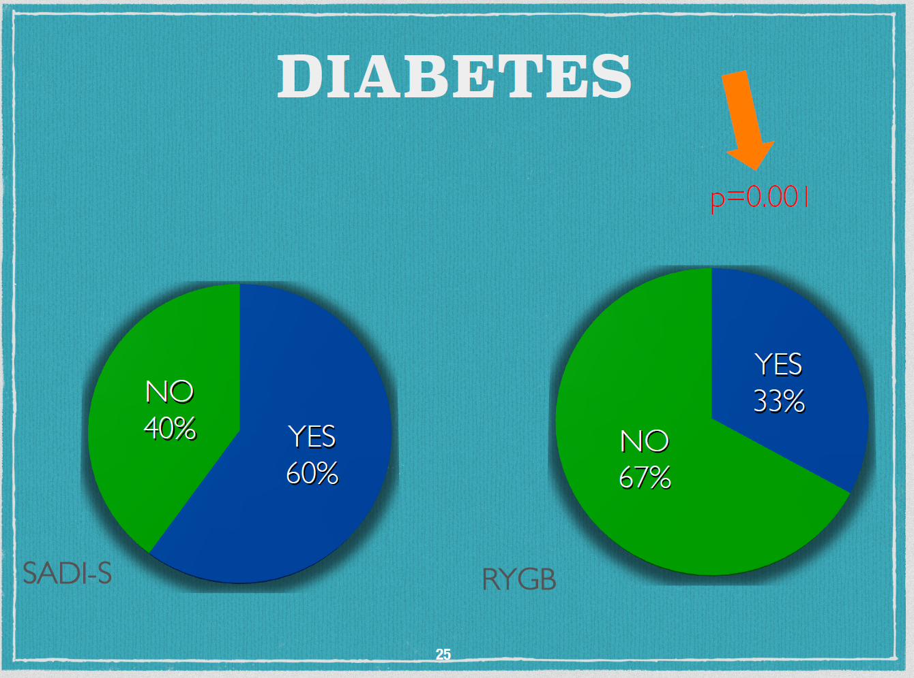

Slide 10
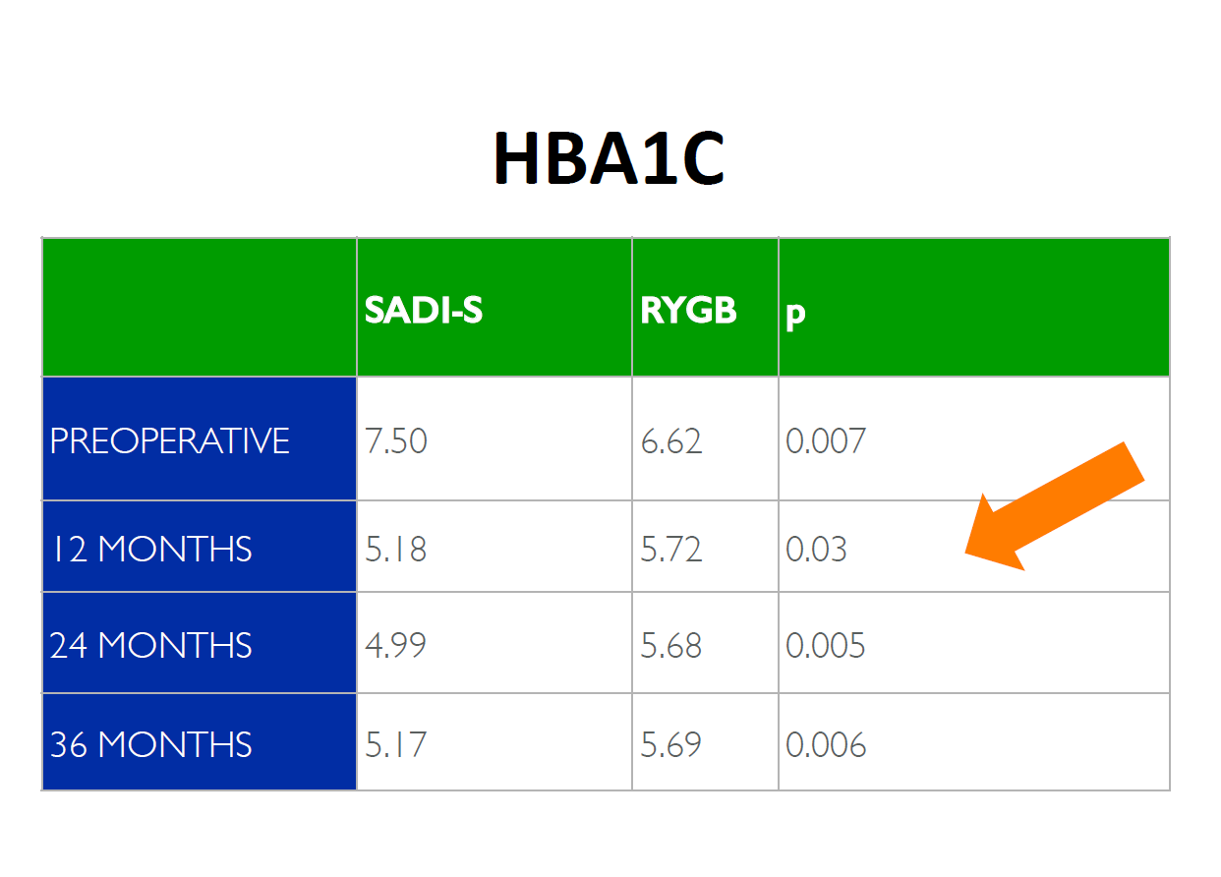
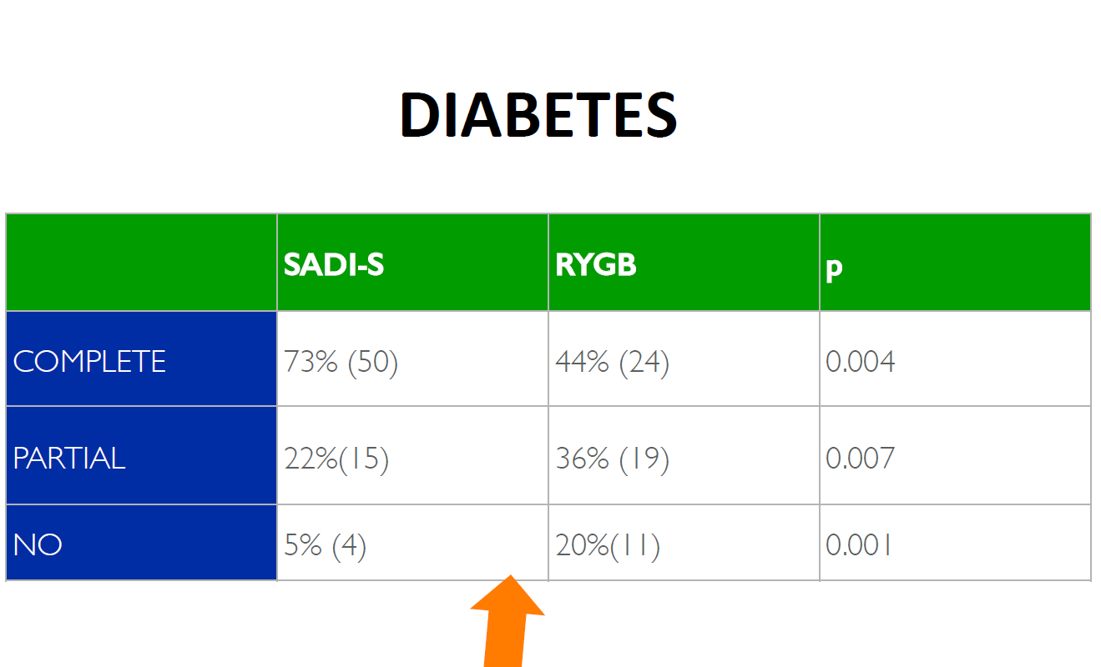

Slide 11
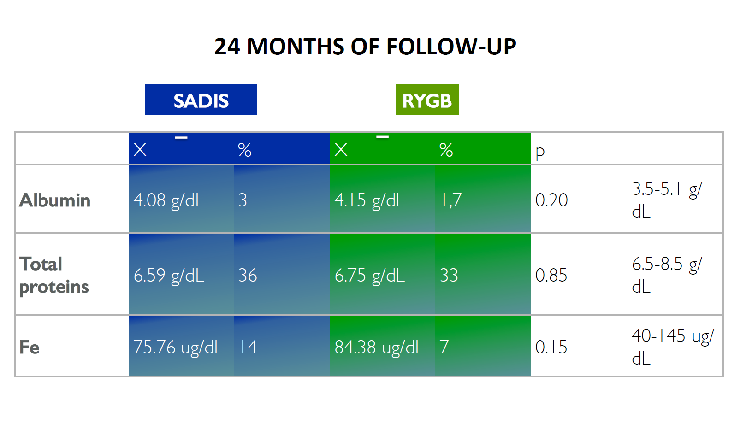

Slide 12
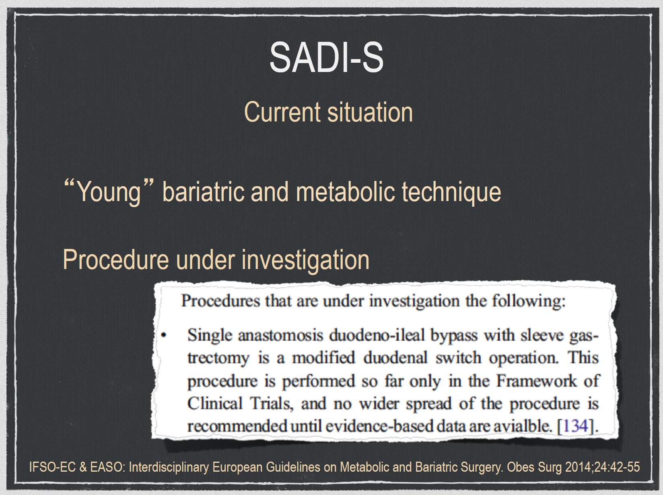

Slide 13
Single anastomosis duodenal switch versus Roux-en-Y gastric bypass in patients with BMI ≥ 50 kg/m²: a multi-centered comparative analysis
Karl Hage ¹, Andre F Teixeira ², Amit Surve ³, Romulo Lind ², Muhammad A Jawad ², Muhammad Ghanem ², Kamal Abi Mosleh ¹, Michael L Kendrick ¹, Daniel Cottam ³, Omar M Ghanem ⁴
Surg End 2024 May
Results: A total of 968 patients (343 RYGB and 625 SADI-S; 68.3% female, age 42.9 ± 12.1 years; BMI 57.3 ± 6.7 kg/m²) with a mean follow-up of 3.6 ± 3.6 years were included. Patients who underwent RYGB were older, more likely to be female, and have a higher rate of sleep apnea (p < 0.001), hypertension (p = 0.015), dyslipidemia (p < 0.001), and type 2 diabetes (p = 0.016) at baseline. The rate of bariatric surgery-specific complications was lower after SADI-S compared to RYGB. We reported no bariatric surgery related deaths after 1 year following both procedures. SADI-S demonstrated statistically higher and sustained weight loss at each time interval compared to RYGB (p < 0.001) even after controlling for multiple confounders. Lastly, the rate of surgical non-responders was lower in the SADI-S cohort.
Conclusions: In our cohort, SADI-S was associated with higher and sustained weight-loss results compared to RYGB. Comorbidity resolution was also higher after SADI-S. Both procedures demonstrate a similar safety profile. Further studies are required to validate the long-term safety of SADI-S compared to other bariatric procedures.
Notes:
STUDIO MULTICENTRICO

Slide 14
Efficacy and safety of single-anastomosis duodeno-ileal bypass with sleeve gastrectomy versus Roux-en-Y gastric bypass in France (SADISLEEVE): results of a randomised, open-label, superiority trial at 2 years of follow-up
Maud Robert ¹, Tigran Poghosyan ², Nicolas Romain-Scelle ³, Sebastien Czernichow ⁴, Dominique Delaunay ⁵, Adrien Sterkers ⁶, Litavan Khamphommala ⁶, Andrea Lazzati ⁷, Claire Blanchard ⁸, Robert Caiazzo ⁹, François Pattou ¹⁰, Emmanuel Disse ¹¹; SADISLEEVE Collaborative Group Lancet 2025 Aug 23
Findings: Between Nov 8, 2018, and Sept 29, 2021, a total of 381 patients were randomly assigned (intention-to-treat population) and included in the primary analysis (SADI-S: 190, RYGB: 191). Mean age was 44·4 years (SD 10·64), mean BMI was 46·2 kg/m² (6·40), 265 (70%) were female, and 79 (21%) had a primary sleeve gastrectomy. 43 (12%) of 370 participants were lost to follow-up. At 2 years, the mean %EWL was statistically significantly higher in the SADI-S group compared with the RYGB group (-76·0% [SD 26·7] vs -68·1% [28·7], confirming the superiority of SADI-S (mean difference -6·72% [95% CI -12·64 to -0·80], p=0·026). The primary outcome was missing for 78 (20%) of 381 participants, with 46 (59%) of 78 participants in the SADI-S group and 32 (41%) of 78 in the RYGB group, p=0·09. The number of serious adverse events related to the surgical technique in the safety population, including all operated patients, was 40 in the SADI-S group including three anastomotic leaks and eight severe diarrhoea compared with 35 in the RYGB group including five internal hernia and five severe abdominal pain cases of which two required diagnostic laparoscopy.
Interpretation: SADI-S showed superior weight loss compared with RYGB at 2 years, with a similar safety profile.

Slide 15
Patient Selection and 30-Day Outcomes of SADI-S Compared to RYGB: a Retrospective Cohort Study of 47,375 Patients
Kevin Verhoeff ¹, Valentin Mocanu ², Uzair Jogiat ², Hayley Forbes ², Noah J Switzer ², Daniel W Birch ³, Shahzeer Karmali ³
Purpose: Single anastomosis duodeno-ileal bypass with sleeve gastrectomy (SADI-S) offers a novel bariatric procedure with few comparative studies evaluating patient selection or perioperative outcomes. We aim to compare SADI-S to Roux-en-Y gastric bypass (RYGB).
Materials and methods: The 2020 Metabolic and Bariatric Accreditation and Quality Improvement Program (MBSAQIP) registry was analyzed, comparing SADI-S to RYGB. Bivariate analysis was performed to determine intergroup differences. Multivariable logistic regression determined factors associated with serious complications and mortality.
Results: We evaluated 47,375 patients, with 501 (1.1%) receiving SADI-S. Patients undergoing SADI-S had higher body mass index (51.4 ± 9.7 kg/m² SADI-S vs. 44.6 ± 7.9 kg/m² RYGB; p < 0.001), and more metabolic comorbidities including non-insulin dependent diabetes (21.7% SADI-S vs 19.0% RYGB; p = 0.011), insulin dependent diabetes (12.0% SADI-S vs. 8.6% RYGB; p = 0.011), and hypertension (54.9% SADI-S vs 47.6% RYGB; p < 0.001). Patients undergoing SADI-S experienced more anastomotic leaks (2.2% vs. 0.5%; p < 0.001), reoperations (5.0% vs 2.6%; p < 0.001), pneumonias (1.6% vs 0.5%; p < 0.001), had sepsis more frequently (1.4% vs 0.3%; p < 0.001), and required more unplanned reintubations (1.2% vs 0.3%; p = 0.004). SADI-S was independently associated with serious complications (OR 1.45, CI 1.09-1.95, p < 0.001) but was not a predictor of mortality (OR 3.29, p = 0.060).
Conclusions: In comparison to RYGB, patients undergoing SADI-S were found to have more metabolic comorbidities. Compared to RYGB, SADI-S has worse perioperative outcomes and is independently associated with serious complications. It remains unclear whether this represents a learning curve or true findings and prospective studies analyzing the risk-benefit ratio following SADI-S are needed.
Obes Surg 2022 Jul;32(7):1-8

Slide 16
Comparison Between Single Anastomosis Duodeno-Ileal Bypass with Sleeve Gastrectomy (SADI-S) and Roux-En-Y Gastric Bypass (RYGB) in Terms of Weight Loss, Associated Medical Problems Remission, and Complications: A Systematic Review with Meta-Analysis
Lucas Sabatella , Daniel Aliseda Jover , Patricia M Ortega , Manuel Fortún Landecho Acha , Fernando Rotellar Sastre , Carlota Tuero Ojanguren , Nuria Blanco Asensio , Adriana Uriz Pagola , Victor Valentí Azcárate Obes Surg. 2025 Jul 22. 10.1007/s11695-025-08092-0.
Methods: A systematic review was conducted following PRISMA guidelines. Studies comparing SADI-S and RYGB as primary surgery were included if they reported weight loss (total weight loss (TWL), excess weight loss (EWL), or body mass index (BMI) changes), associated medical problems remission (diabetes and hypertension), and postoperative outcomes (complications, hospital stay, and operative time). A meta-analysis of mean differences (MD) was conducted to assess continuous outcomes, and a meta-analysis of odds ratios (OR) was performed to evaluate the categorical variables; a random effects model was used.
Results: Eight studies, including 4259 patients (1625 SADI-S; 2634 RYGB), were analysed. Six studies with over 2 years of follow-up (mean 3.93 years (1.79)) were included for long-term outcomes, while all eight were considered for short-term outcomes.
SADI-S resulted in a statistically significant higher total weight loss (MD 10.03; 95% CI 4.7-15.35; p < 0.001), excess weight loss (MD 10.15; 95% CI 5.2-15.1; p < 0.01), diabetes remission (OR 3.48; 95% CI 2.02-6.02; p < 0.001) with a similar number of long-term complications (OR = 0.19, 95% CI 0.03-1.36; p = 0.10). Short-term complications were inferior in the subgroup of patients undergoing SADI-S with < 50 kg/m² of BMI (OR 0.45, 95% CI 0.33 to 0.61; p < 0.01) as well as hospital stay (MD = -0.69; 95% CI -1.03 to -0.36, p < 0.01) and severe complications (OR = 0.44, 95% CI 0.25-0.80; p = 0.01).
Conclusions: This meta-analysis suggests that SADI-S may offer advantages over RYGB in terms of weight loss, diabetes remission, and safety profile.
Notes:
Studio molto importante PRISMA (Preferred Reporting Items for Systematic Reviews and Meta-Analyses)

Slide 17
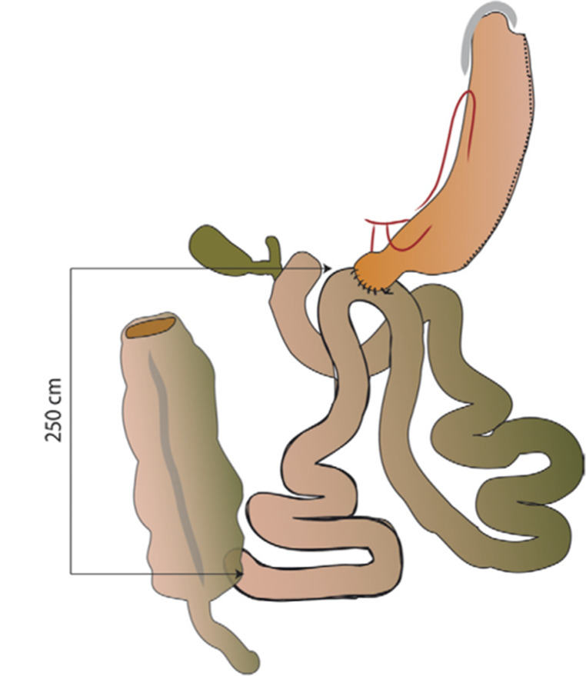
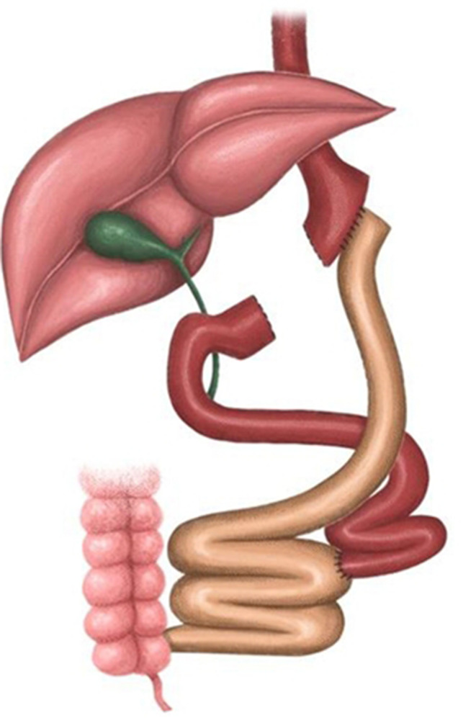
Long-term results of Roux-en-Y gastric bypass (RYGB) versus single anastomosis duodeno-ileal bypass (SADI) as revisional procedures after failed sleeve gastrectomy: a systematic literature review and pooled analysis
Theodoros Thomopoulos ¹, Styliani Mantziari ² ³, Gaëtan-Romain Joliat ² ³ Langenbecks Arch Surg 2024 Nov 23;409(1):354
Methods: A systematic review was performed from 2007 to September 2024. Articles were included if SADI or RYGB were performed as RBS after 'failed SG' with follow-up at least 5 years.
Pooled analysis was performed to summarize the data.
Results: Among the seven studies eligible and included in this review, the SADI procedure showed comparable results to RYGB in terms of weight loss, nutritional deficiencies, and resolution of comorbidities during the long-term follow-up. However, RYGB proved superior in terms of remission of reflux disease and other functional problems after SG.
Conclusions: The present review found that SADI seems to be a promising and suitable method for suboptimal weight loss after SG, with comparable or even better results to RYGB after 5-year follow-up.
Notes:
Uno studio sulla redo surgery

Slide 18
SADI-S, state of the art. Indications and results in 2024: a systematic review of literature
Livia Palmieri, Francesco Pennestrì, Marco Raffaelli
Abstract
Single Anastomosis Duodeno-Ileal Bypass with Sleeve Gastrectomy (SADI-S) was proposed as a simplification of the biliopancreatic diversion (BPD) procedure with duodenal switch (DS) in order to reduce operative time and postoperative complications rate, however, keeping effectiveness in weight loss and in comorbidities’ resolution.
We performed a systematic review of the literature with the aim of summarizing the current evidence of SADI-S clinical outcomes in order to assess its effectiveness and safety, and a total of 17 studies were included.
Short- and mid-term follow-up results were reported, with a mean TWL loss ≥ 25% at 12 months and > 44% after 24 months,
comparable to BPD-DS, also in reoperative surgery.
Comorbidity remission rates for T2D, hypertension, dyslipidemia and OSAS were of 75.8%, 61.2%, 60.4%, 71.9%, respectively.
Some nutritional deficiencies were reported (total proteins, albumin, folate, Vitamin B12 and Vitamin D),
but the hypoabsorption rate decreased with the lengthening of the common limb to 250/300 cm.
SADI-S can be defined as an efficient bariatric operation both as primary and reoperative procedure for recurrent weight gain,
with good results in comorbidity resolution.

Slide 19
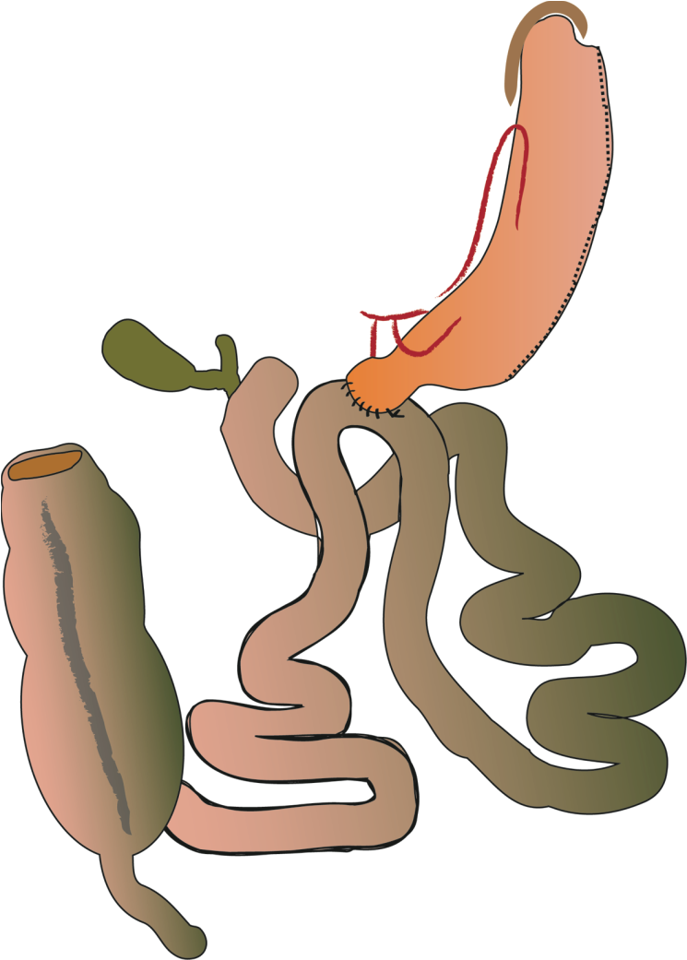
CONCLUSION

Slide 20

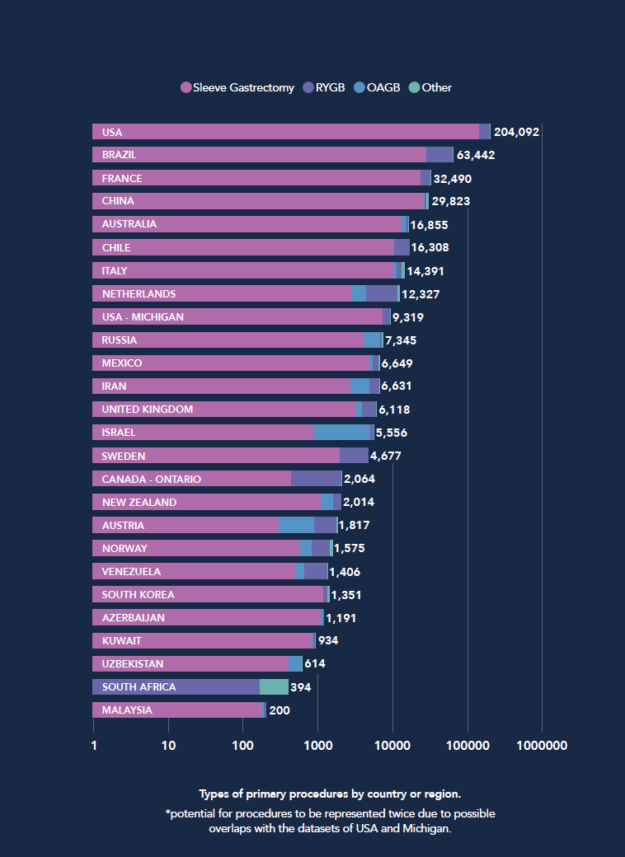
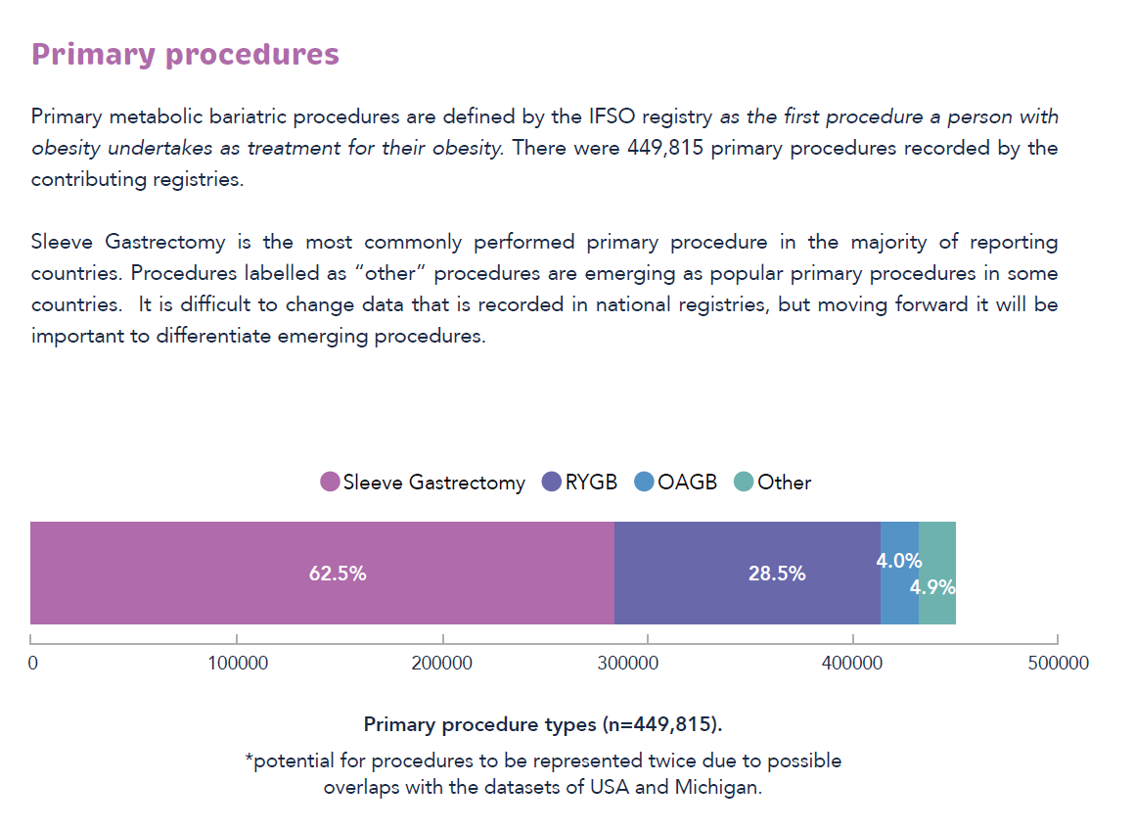
2024

Slide 21

CONCLUSION
In SADI-S…
Single anastomosis
No opening of meso
Less surgical time
Less bowel movements.

Slide 22
CONCLUSION
But
In SADI-S…
a high prevalence of macro-nutrient deficiencies
the need for Nutrient Supplements Daily and…FOR LIFE!!!

Slide 23
CONCLUSION
In RYGBP
Roux-en-Y gastric bypass (RYGB) has traditionally been considered the gold standard due to its balance between efficacy and safety.

Slide 24
CONCLUSION
SIXTY YEARS OF GASTRIC BYPASS
Fact
Gastric bypass has been the most frequently performed metabolic/bariatric operation in the history of bariatric surgery.
Prediction
Gastric bypass will remain in the metabolic/bariatric armamentarium in the future of bariatric surgery.
Henry Buchwald, M.D., Ph.D., HonFRCS
Notes:
Come non essere d’accordo con Buchwald……

Slide 25
Grazie

Slide 28
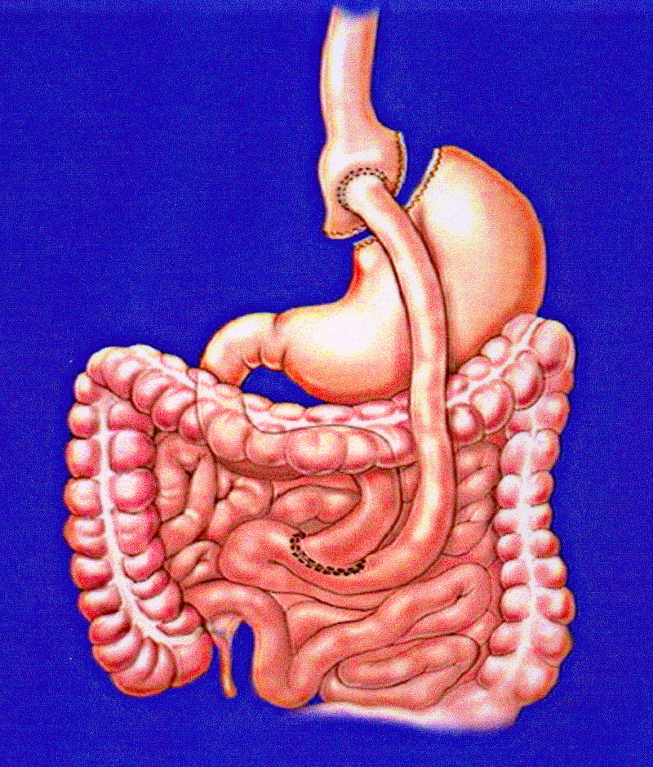
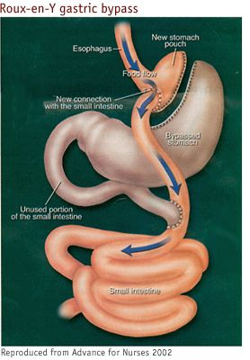
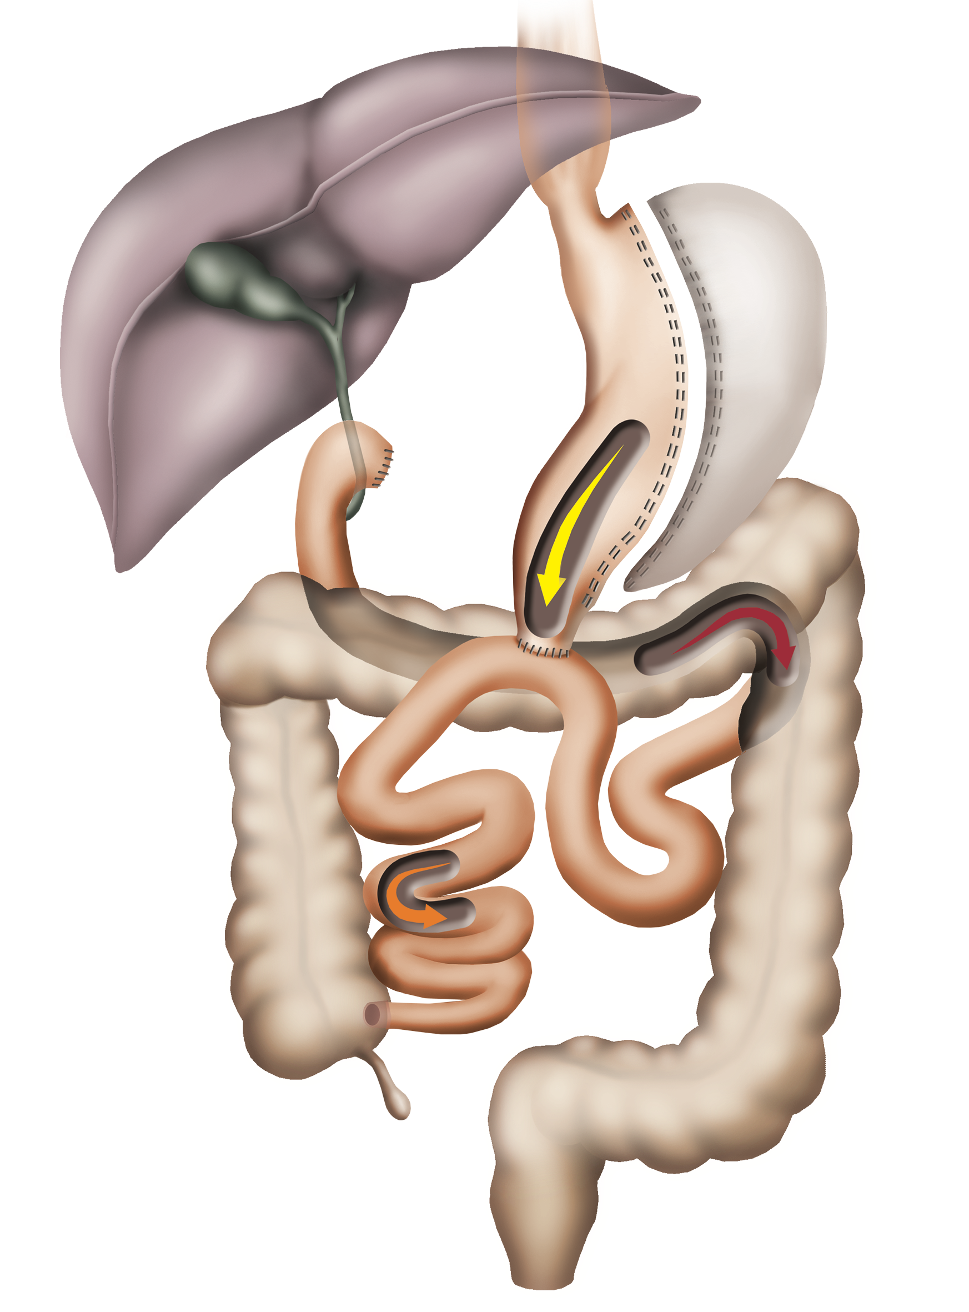
Notes:
A proposta é de um tubo mais fino que o sleeve proposto originalmente do BPD-DS

Slide 29
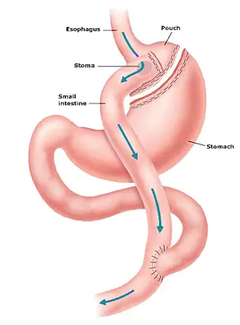

Slide 30
